Slide 1
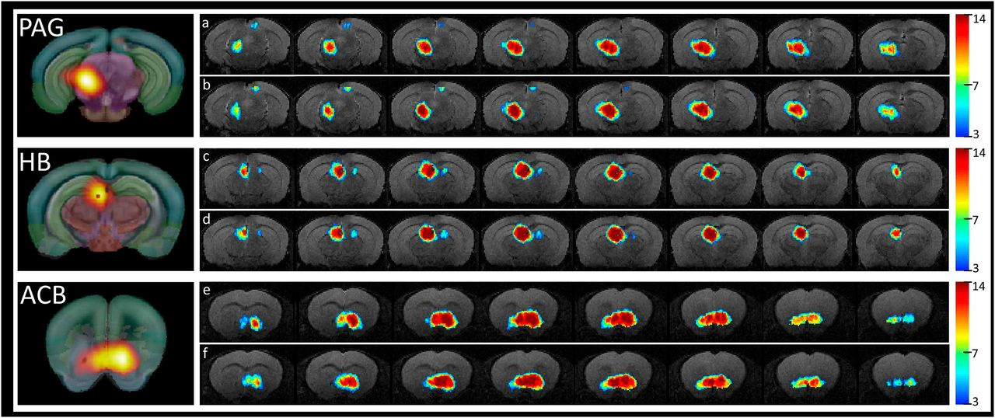
Incidence maps showing the spatial distribution and reproducibility of the PAG (A and B), HB (C and D), and ACB (E and F) functional clusters revealed via ICASSO, shown for each animal group separately (A, C, E correspond to the Ctrl group and B, D, F corre...
Anna E. Mechling et al. PNAS 2016;113:11603-11608
©2016 by National Academy of Sciences
Notes:
Incidence maps showing the spatial distribution and reproducibility of the PAG (A and B), HB (C and D), and ACB (E and F) functional clusters revealed via ICASSO, shown for each animal group separately (A, C, E correspond to the Ctrl group and B, D, F corresponding to the Oprm1^{−/−} group). The color codes the number of animals in which the spatial map overlay the indicated anatomical area. We only show the patterns replicated more than three times. On the left side, the ICASSO group spatial components corresponding to PAG, HB, and ACB are provided.

